Slide 1
MCT 9 B – Self-Esteem
© Moritz & Woodward, 02|24

Slide 2
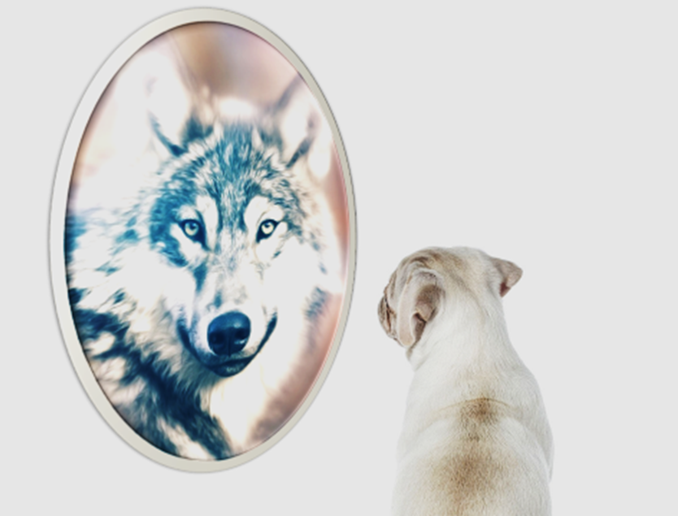
Self-esteem: What is it?
nach Burns, 1982
???

Slide 3
Self-esteem: What is it?
nach Burns, 1982
Our personal view of ourselves, independent of other people's opinions.

Slide 4
Self-esteem: What is it?
nach Burns, 1982
Our personal view of ourselves, independent of other people's opinions.
Who am I?
                What can I do?

Slide 5
Self-esteem: What is it?
nach Burns, 1982
Our personal view of ourselves, independent of other people's opinions.
Who am I?
                What can I do?
                Subjective value

Slide 6
What diminishes self-esteem?
???

Slide 7
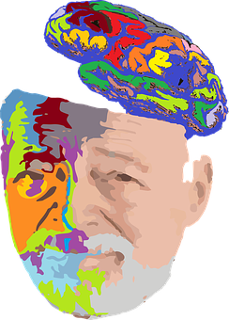
What diminishes self-esteem?
Biological factors:
Strong activation of the brain structures that evoke anxiety (amygdala)
Genes: internal and external characteristics that are inherited (e.g., certain impairments)
Social/environmental:
Low appreciation from one‘s social environment (parents, schoolmates/work colleagues, etc.)
External influences (e.g., unemployment)
Psyche:
Certain personality traits such as shyness, anxiety
Bio
Social
Psyche

Slide 8
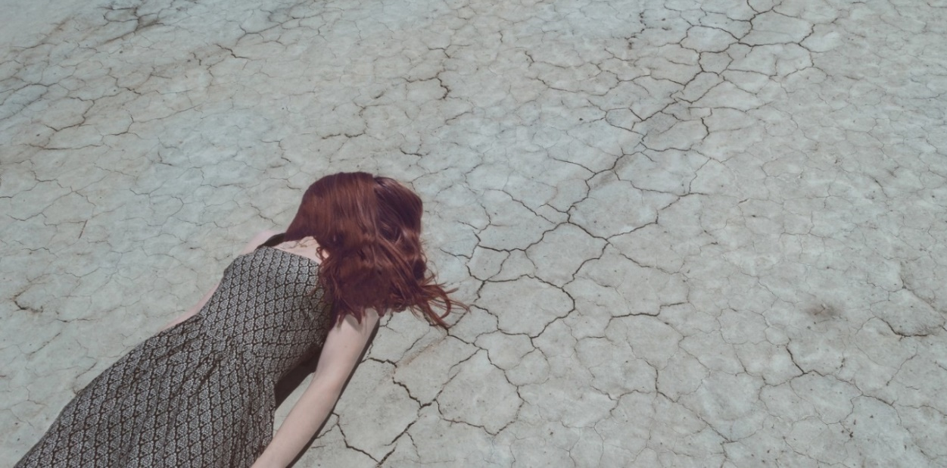
Why are we doing this?
Many (but not all!) people with psychosis have low self-esteem, often due to negative interpersonal experiences.
Improving self-esteem and other depressive symptoms increases mental stability.
This can also help to reduce psychotic symptoms.

Slide 9
Low self-esteem can impact our mental health
People with mental illness often suffer from low self-esteem.
Low self-esteem may contribute to psychological problems such as:
    Self-doubt
    Fear
    Depressive symptoms
    Loneliness

Slide 10

Differences between exaggerated self-esteem and healthy self-esteem
During psychosis, many of those affected (but not all) feel persecuted or compromised. This feeling can lead to reduced self-esteem.
On the other hand, some can feel increased self-esteem if they feel destined for special tasks or believe they were chosen for an important mission.

Slide 11

Healthy self-esteem?
CAUTION: Ideas of megalomania (e.g., the belief that you are more powerful or more important than others) have nothing to do with "healthy" self-esteem!
This feeling won’t last long
... and it is not based on reality and actual strengths.

Slide 12
Healthy self-esteem
All people have real strengths, often only waiting to be discovered.
You can and should be proud of these strengths!
Awareness of these strengths form the basis of your self-esteem.

Slide 13
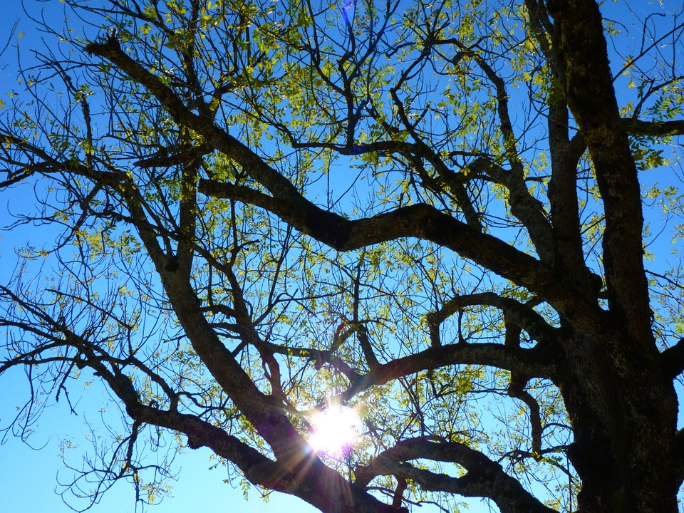
"Branches" of self-esteem
Self-esteem is not a constant value; it may be stronger or weaker in different areas of your life
Relationships
Occupation
Leisure time
Sports
Appearance

Slide 14
"Branches" of self-esteem
Do we focus only on our weaknesses (weak branches) or do we also appreciate our strengths (strong branches)?
Relationships
Occupation
Leisure time
Sports
Appearance

Slide 15
People with low self-esteem
… tend to focus on their weaknesses (weak branches) and tend to make negative self-judgments ("I can't do anything right").
I‘m failing all my exams. I‘m not good enough.
My boss is never satisfied with me.
Relationships
Occupation
Leisure time
Sports
Appearance

Slide 16
People with low self-esteem
… tend to focus on their weaknesses (weak branches) and tend to make negative self-judgments ("I can't do anything right").
I‘m currently without a job and the last interview didn't go so well.
I am a good listener and make my friends laugh.
Relationships
Occupation
I love reading and cooking.
I haven‘t played any sports for a long time, although I've always enjoyed it.
Leisure time
Sports
Appearance
I don't think my nose is that pretty, but I'm still happy with myself.

Slide 17

What are the external (visible) characteristics of healthy self-esteem?
Voice: ???
Facial expression/gestures: ???
Posture: ???

Slide 18
What are the external (visible) characteristics of healthy self-esteem?
Voice: clear, well-articulated, appropriate volume
Facial expression/gestures: keeping eye contact; confident appearance
Posture: upright
As with anything: don't overdo it (e.g., staring at other people, interrupting them constantly, bossing others around).

Slide 19
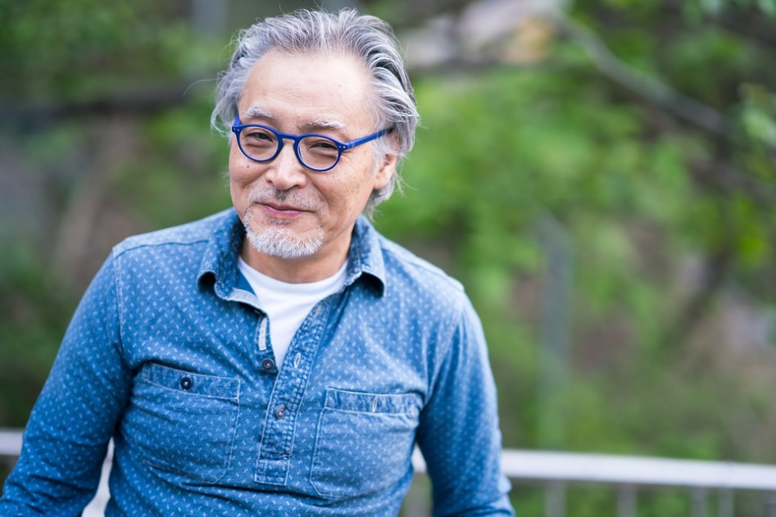
Characteristics of high self-esteem that are not directly observable
???

Slide 20
Characteristics of high self-esteem that are not directly observable
Confidence in one's own ability.
Accepting one's own errors or failures (without devaluing oneself).
Self-reflection and willingness to learn from one's own errors or failures.
Positive attitude towards oneself, for example, congratulating oneself for a success.

Slide 21

Realizing your strengths
Why is identifying our own strengths so difficult sometimes?

Slide 22
Realizing your strengths
Why is identifying our own strengths so difficult sometimes?
Unhelpful assumption: "If I praise myself, I'll become vain."
People often don't want to reveal their own strengths due to shame or being seen as arrogant.
Important: Try to find the "optimal balance"! Tell other people about your own strengths while also recognizing and appreciating their strengths!

Slide 23
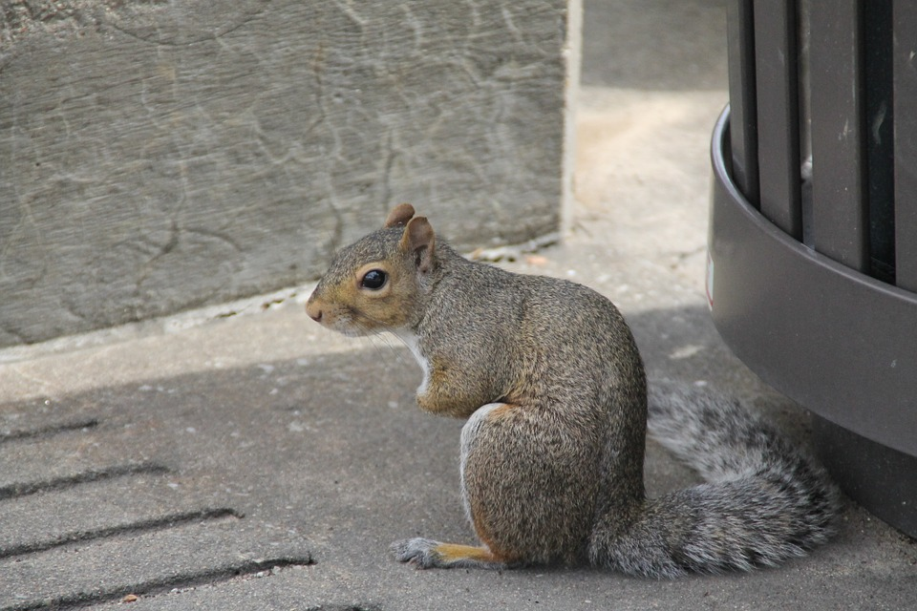
Exercise
Stand up.
Let your shoulders and your arms dangle, and arch your back a little.
Now tilt your head downwards.

Slide 24
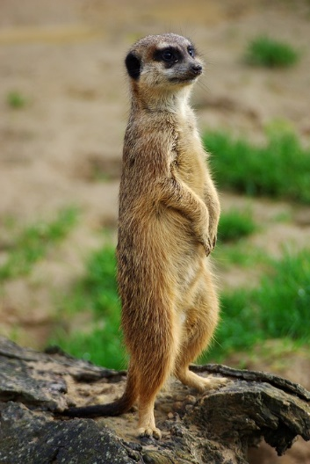
Exercise
Slowly straighten your spine so that you are standing completely upright.
Stand with your feet hip-width apart so that you have a firm footing.
Let your arms hang loosely beside your body.
Create body tension, as if someone is pulling you up by a thread.
Keep your eyes to the front.

Slide 25
Exercise
How do these exercises make you feel?
Which posture makes you feel stronger?

Slide 26

Exercise
You probably feel stronger in the upright posture.
According to research, an upright, stable posture (also known as power posing) actually makes you feel stronger! (Carney et al., 2010; Ranehill et al., 2015)
Carney D. R., Cuddy A. J. C., Yap A. J. (2010). Power posing: Brief nonverbal displays affect neuroendocrine levels and risk tolerance. Psychological Science, 21, 1363–1368.
Ranehill et al. (2015). Assessing the Robustness of Power Posing. No Effect on Hormones and Risk Tolerance in a Large Sample of Men and Women. Psychological Science, 26 (5), 653-656.

Slide 27
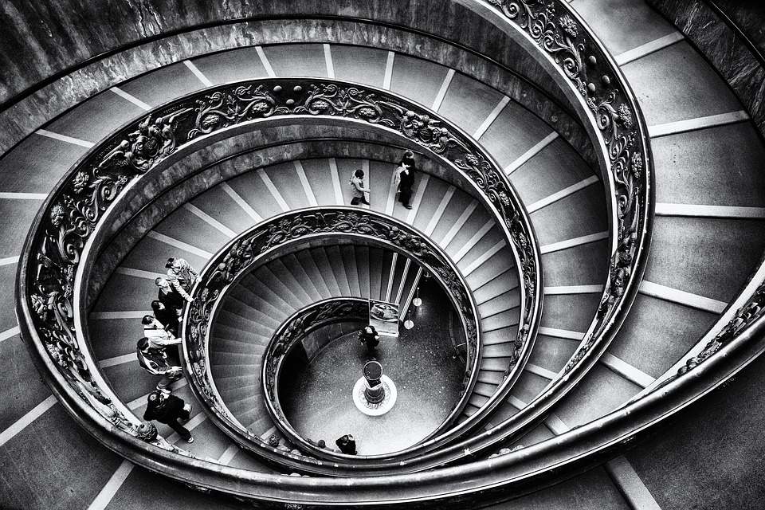
Ruminating: Spinning in circles but not moving forward
Many people with psychological symptoms suffer from endless "ruminating" or "brooding."
Have you noticed yourself ruminating?

Slide 28
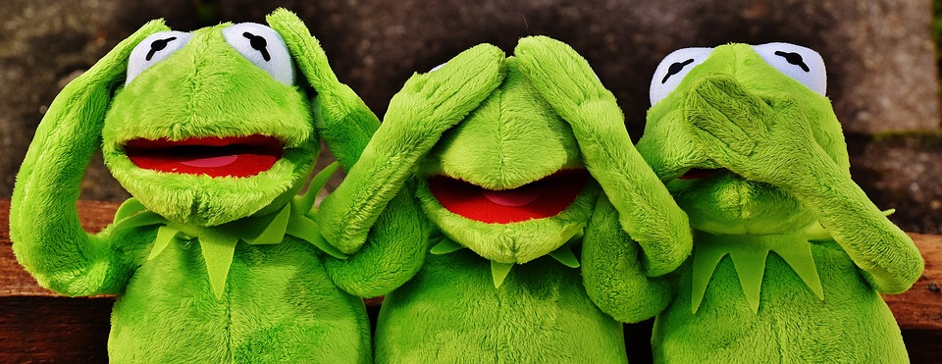
Problems
Ruminating is problematic for several reasons:
The thoughts are running in circles; your problems gain more and more presence/visibility without being solved.
Self-esteem is further undermined because useful and helpful thoughts or actions are not attended to or even noticed.
Unlike goal-directed thinking, ruminating is characterized by the unsuccessful thoughts and self-accusations manifesting again and again.

Slide 29
What to do?
The first and most important step is to acknowledge that rumination is a problem rather than a helpful strategy. Rumination clearly leads to more problems instead of solving them.
Ruminating thoughts are just thoughts. They're not reality!
Try to notice the thought, but do not judge it!

Slide 30
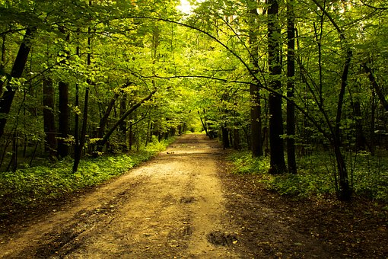
Anti-rumination exercise 1:
Shifting attention
Focus your attention on your surroundings not on yourself.
Pay attention to sounds, smells, or colors.
Try this exercise during a walk, where you can pay attention to as many details as possible without judgment.
Your problematic thoughts are not persistent because they are true but because they scare you. That‘s why you think about them repeatedly.

Slide 31
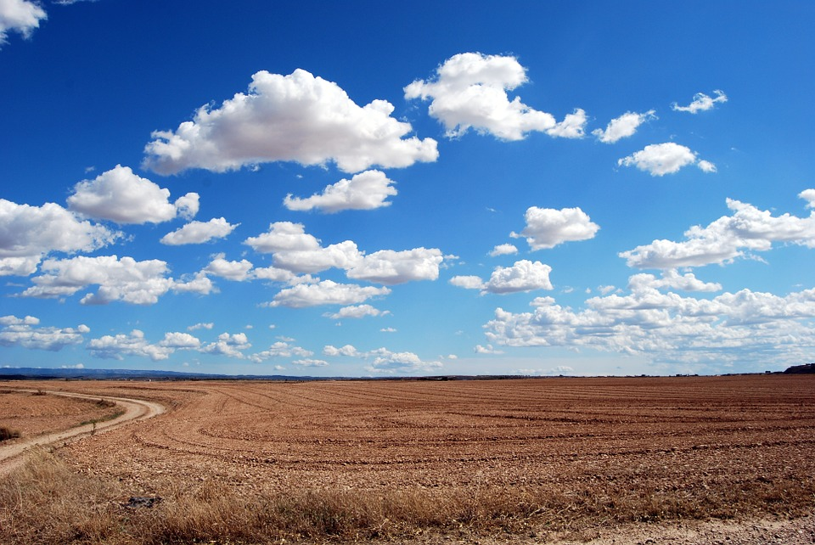
Anti-rumination exercise 2:
Letting your thoughts "float away"
Close your eyes.
Which unpleasant thought is the most intrusive right now?
Let it float away—without any judgment— as if it‘s on a cloud!

Slide 32
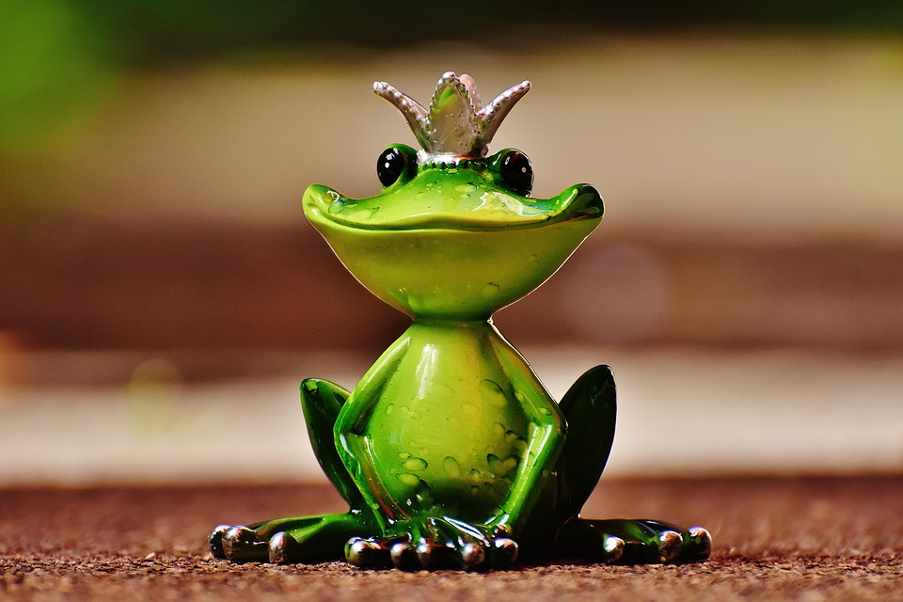
Homework
Smiling at others makes you happy! Try smiling at other people (on the street, at work, etc.), even if you don't really feel like it.
You will notice that some people smile back at you. The reason why laughter can be contagious are the so-called mirror neurons in your brain!
Not everyone will return the smile. This is OK.

Slide 33
Laughter is contagious: The role of mirror neurons
How do mirror neurons work? (Rizzolatti & Sinigaglia, 2007)
Mirror neurons are certain nerve cells in the brain that send out signals whenever you are observing other people's feelings or actions (e.g., fatigue, happiness, yawning, laughing) and make you feel the same or even act the same as the other person!
So, if you observe a laughing, happy person, it is very likely that you will also laugh and be happy—and vice versa! This works especially well with yawning.
Rizzolatti, G. & Sinigaglia, C. (2007). Mirror neurons and motor intentionality. Functional Neurology, 22 (4), 205-210.

Slide 34
Transfer to everyday life
Learning objectives:
Self-esteem is how we value and perceive ourselves.
Become aware of your strengths in different areas of your life and try to improve your self-esteem using the strategies we’ve discussed (visible and invisible characteristics!).
Search for forgotten strengths ("hidden treasures") by asking your friends or by keeping a daily joy diary.
Be mindful of the positive moments that happen in your day!

Slide 35
What does this have to do with psychosis?
Many (but not all!) people with psychosis have low self-esteem and have negative thought patterns (e.g., a tendency to brood), which can further reduce their self-esteem.

Slide 36
What does this have to do with psychosis?
Many (but not all!) people with psychosis have low self-esteem and have negative thought patterns (e.g., a tendency to brood), which can further reduce their self-esteem.
Example: Emma fails the practical driving test.
Evaluation: She is disappointed in herself and initially doubts that she will ever pass the driving test. Ultimately, she also devalues herself as a whole person and feels "very small." She wonders whether she will ever pass a test or whether her whole life will fall short of her potential.
But, Emma's best friend is able to build her up a little over the following days by reminding her that her driving instructor often praised her. She was also very nervous before the test, and the failure rate for the first test is quite high. Together, they think about how Emma can manage her disappointment better. However, it is also important that she is aware of her other driving successes and keeps her other strengths (e.g., at work) in mind. The driving test is important, but it says nothing about Emma as a person as a whole.
Important: Even if you fail at something, you should never ignore the things that go well in your life!

Slide 37


Thank you for your attention!
for trainers:
Please hand out worksheets. Introduce our app COGITO (download free of charge).
www.uke.de/mct_app

Slide 38
Pictures used in this module are reproduced with indirect (creative commons license) or direct permission of the artists listed below, for which we would like to express our gratitude! A full list can be obtained via www.uke.de/mct. If we have involuntarily breached copyright, please accept our apologies. In this case, we kindly ask creators for their permission to use their work under the "fair use" policy.
Die in diesem Modul verwendeten Bilder wurden mit der indirekten (creative commons Lizenz) oder direkten Zustimmung der untenstehenden Künstler reproduziert, wofür wir uns herzlich bedanken möchten! Eine vollständige Liste ist hinterlegt auf www.uke.de/mkt. Sollten wir unbeabsichtigt gegen das Urheberrecht verstoßen haben, so bitten wir dies vielmals zu entschuldigen und bitten nachträglich um die Verwendungserlaubnis.
Name Photographer/Artist Name Fotograf/Künstler | Source/ Quelle | Picture Name/ Name des Bildes | CC = used with corresponding creative commons license; PP = used with personal permission of artist CC = genutzt unter creative commons Lizenz, PP = verwendet mit persönlicher Zustimmung des Künstlers | Description/Kurzbeschreibung
Werner22Brigitte | Pixabay | Wolf Raubtier Canidae Canis Lupus Jäger | CC0 | wolf and dog/Wolf und Hund
DonkeyHotey | Pixabay | Stop Sign | CC | stop sign/Stoppschild
Pramit_marattha | Pixabay | Alter Mann Porträt Gehirn Großvater Bunter Mann Mann | CC0 | Man with coloured brain/Mann mit buntem Gehirn
Free-Photos | Pixabay | Metapher | CC0 | Girl on the ground/Mädchen am Boden
Geralt | Pixabay | Hände Anzug Euro Münze Schein Armut Reichtum | CC0 | hands with money/Hände und Geld
Unsplash | Pixabay | Wunderkerze Feuerwerk Hand Person Menschliche | CC0 | sparkler/Wunderkerze
Logga/Wiggler | Pixabay | Baum Äste Geäst Gegenlicht Sonne Weide | CC0 | Baum
PublicDomainPictures | Pixabay | Brünette Niedlich Mode Weiblich Mädchen | CC0 | Lächelnde Frau
Pexels | Pixabay | Alter Mann Ältere Menschen Mann Person Lächelnd | CC0 | Mann mit Brille

Slide 39
Pictures used in this module are reproduced with indirect (creative commons license) or direct permission of the artists listed below, for which we would like to express our gratitude! A full list can be obtained via www.uke.de/mct. If we have involuntarily breached copyright, please accept our apologies. In this case, we kindly ask creators for their permission to use their work under the "fair use" policy.
Die in diesem Modul verwendeten Bilder wurden mit der indirekten (creative commons Lizenz) oder direkten Zustimmung der untenstehenden Künstler reproduziert, wofür wir uns herzlich bedanken möchten! Eine vollständige Liste ist hinterlegt auf www.uke.de/mkt. Sollten wir unbeabsichtigt gegen das Urheberrecht verstoßen haben, so bitten wir dies vielmals zu entschuldigen und bitten nachträglich um die Verwendungserlaubnis.
Name Photographer/Artist Name Fotograf/Künstler | Source/ Quelle | Picture Name/ Name des Bildes | CC = used with corresponding creative commons license; PP = used with personal permission of artist CC = genutzt unter creative commons Lizenz, PP = verwendet mit persönlicher Zustimmung des Künstlers | Description/Kurzbeschreibung
Bessi | Pixabay | Margerite Gänseblümchen Schöne Schönheit Blüte | CC0 | Gänseblümchen
Godsgirl_Madi | Pixabay | Eichhörnchen Gebeugt Sitzen Niedlich Buschig | CC0 | Eichhörnchen
Lucky2013 | Pixabay | Erdmännchen Tier Zoo Foto Erdmaennchen Natur | CC0 | Erdmännchen
ErikaWittlieb | Pixabay | Wonder Woman Superhelden Starke Stärke Kostüm | CC0 | Wonder Woman
WenPhotos | Pixabay | Vatikan Treppe Grafiken Rom Geometrie | CC0 | Treppenhaus
Alexas_Fotos | Pixabay | Nicht Hören Nicht Sehen Nicht Sprechen Lustig | CC0 | Frösche/Kermit
Pluteser | Pixabay | Natur Park Gasse Stadtpark Belebten Natur | CC0 | Waldweg
Pcdazero | Pixabay | Feld Wolken Himmel Erde Horizont Pflügen Bewölkt | CC0 | Himmel und Feld
Alexas_Fotos | Pixabay | Frosch Froschkönig Krone Figur Niedlich Lustig | CC0 | Froschkönig

